Slide 1
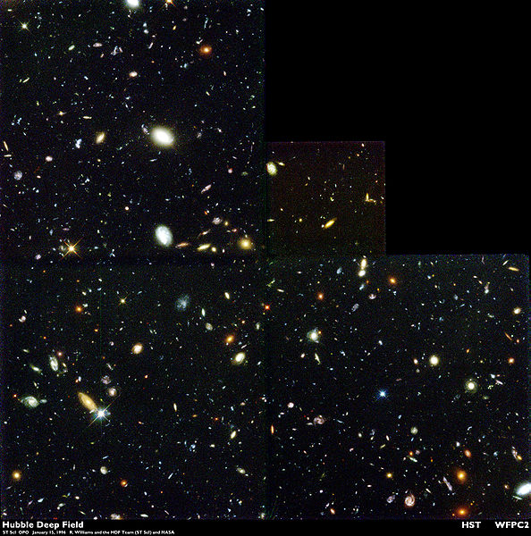
AGB POPULATION IN GALAXIES
Paolo Battinelli OA Roma INAF battinel@inaf.it
Serge Demers U. de Montréal demers@astro.umontreal.ca
WHY?
High redshift galaxies
Up to 80% of the K-band luminosity in a 1 Gyr old simple stellar population comes from AGB stars

Slide 2
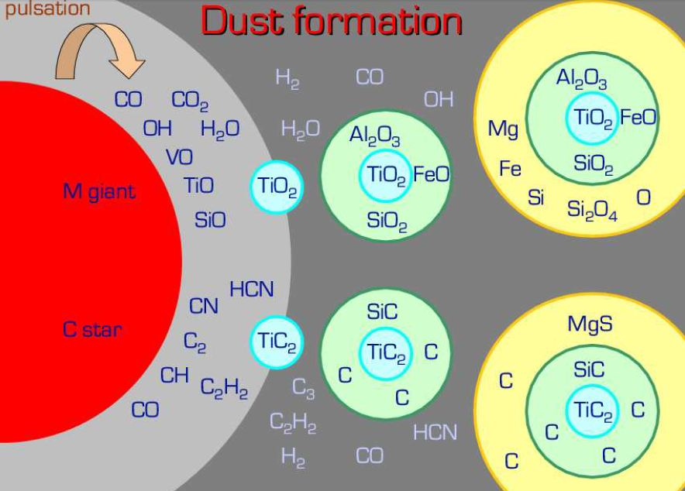
AGB POPULATION IN GALAXIES
WHY?
High redshift galaxies
Chemical enrichment
AGB stars shed much, often most, of their initial mass in the form of dusty
winds before leaving a white dwarf behind.

Slide 3
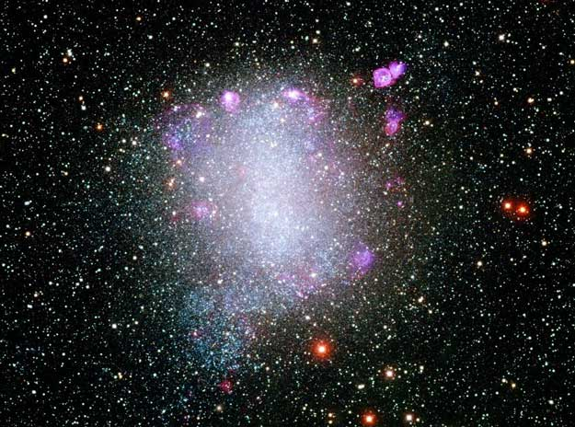
AGB POPULATION IN GALAXIES
WHY?
High redshift galaxies
Chemical enrichment
Galaxies in the
Local Universe
AGB stars have revealed unexpected features and structures in several Local Group galaxies
NGC 6822

Slide 4
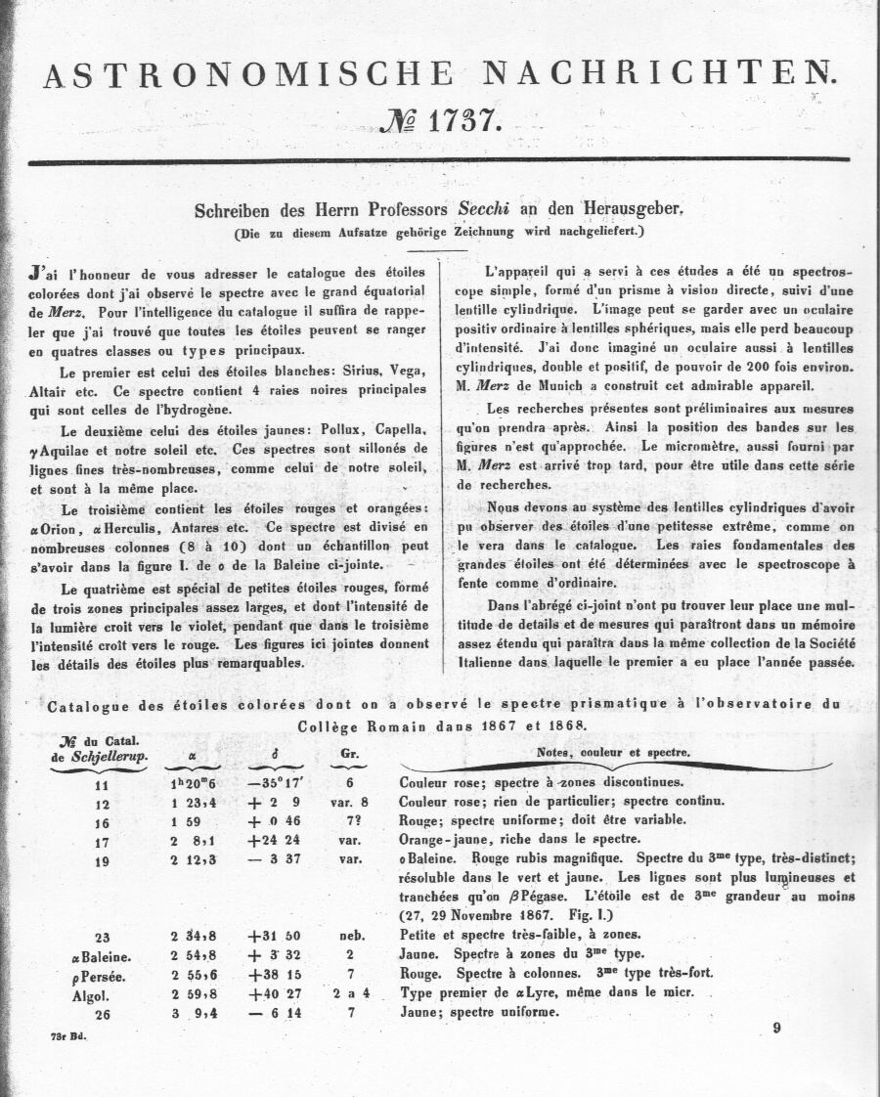
The beginning…
Roma,
4 novembre 1868

Slide 5
The first Carbon Star is discovered!
“…there is a marked analogy with the reversed spectrum of carbon.”

Slide 6
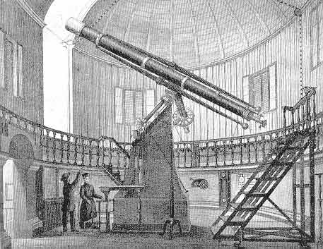
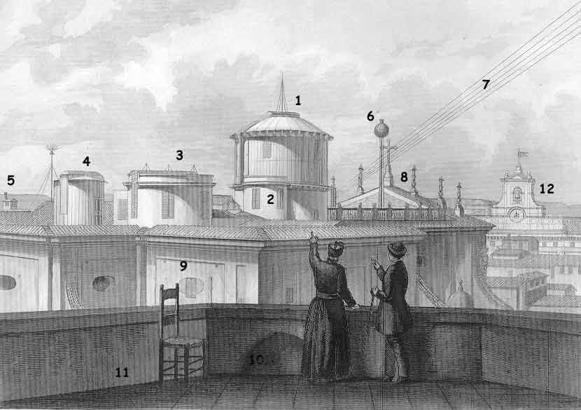
Osservatorio del Collegio Romano
late XIX century
(Secchi realized a former Boscovich’s idea)

Slide 7
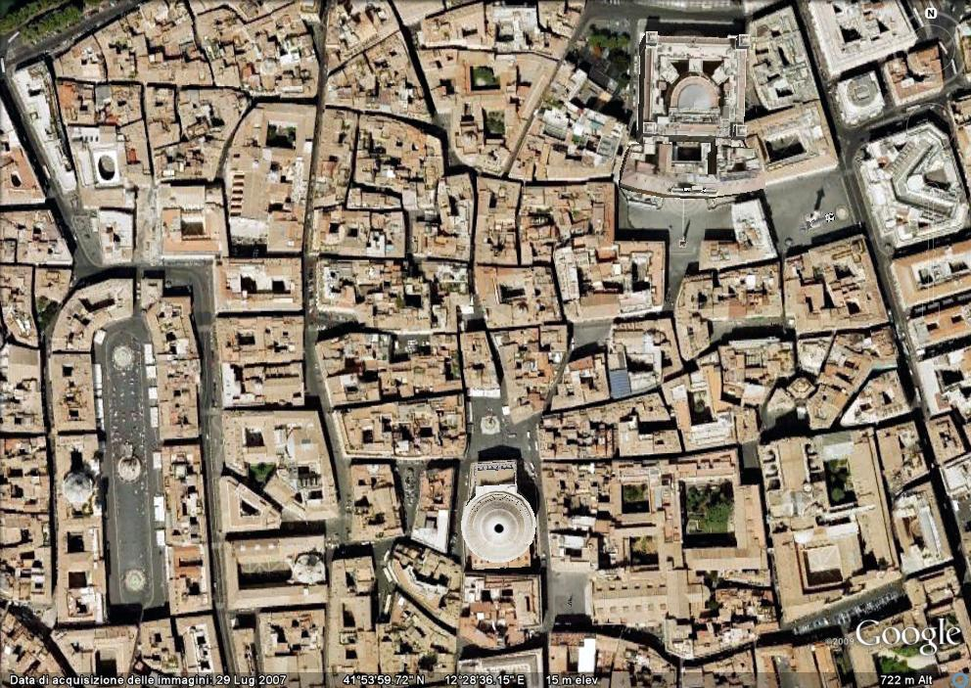
...the Observatory today

Slide 8
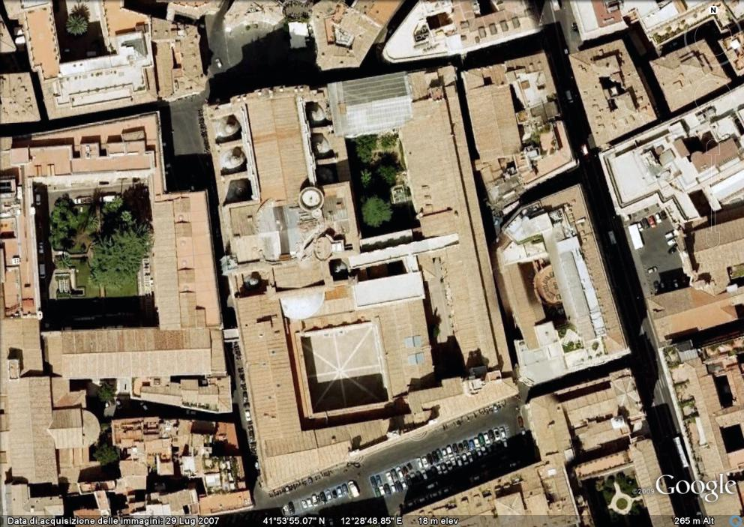
...the Observatory today

Slide 9
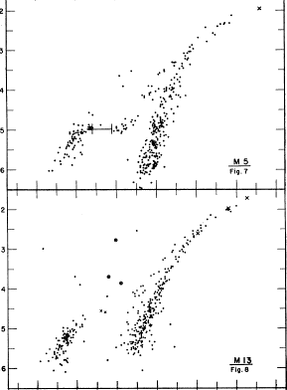
In the 1950's astronomers started to produce photographic CMDs. Arp (1955) observed several globular clusters and showed that they differ between each other. He observed a double giant branch and he called it: "bifurcation of the giant sequence".
1955 (Arp) bifurcation of the giant sequence
1966 (Sandage&Walker) the term “asymptotic branch” appeared
1970 (Iben&Rood) double-shell nature of AGB stars
1973 (Iben) thermal instability, dredge-up responsible of the peculiar C abundances.
1973 (Catchpole&Feast; Feast&Lloyd-Evans) C stars in intermediate-age MC clusters
Notes:
9

Slide 10
AGB STARS
M stars
O-rich
Carbon stars
C-rich
˚K
classical carbon stars
C-R: | the old Harvard class R: are still visible at the blue end of the spectrum, strong isotopic bands, no enhanced Ba line |  | medium disc pop I | Red-giants? | 5100-2800
C-N: | the old Harvard class N: heavy diffuse blue absorption, sometimes invisible in blue, s-process elements enhanced over solar abundance, weak isotopic bands |  | thin disc pop I | AGB | 3100-2600
non-classical carbon stars
C-J: |  | very strong isotopic bands of C₂ and CN | unknown | unknown | 3900-2800
C-H: |  | very strong CH absorption | halo pop II | bright giants, mass transfer (all C-H:s are binary ) | 5000-4100
Keenan, 1993 revised classification

Slide 11
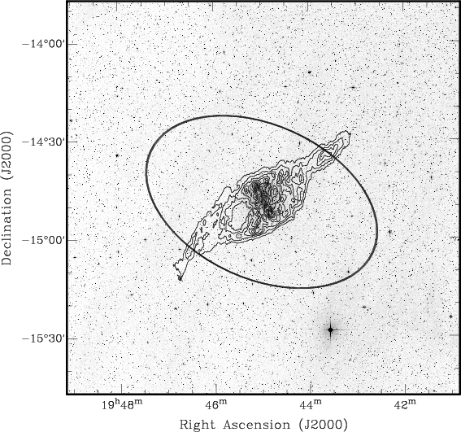
C STARS as tracers in low-density regions
2°x 2°
The essentially negligible foreground contamination makes C N-type stars extremely useful in low density outskirts of galaxies
NGC 6822 - Battinelli, Demers, Kunkel, 2006

Slide 12
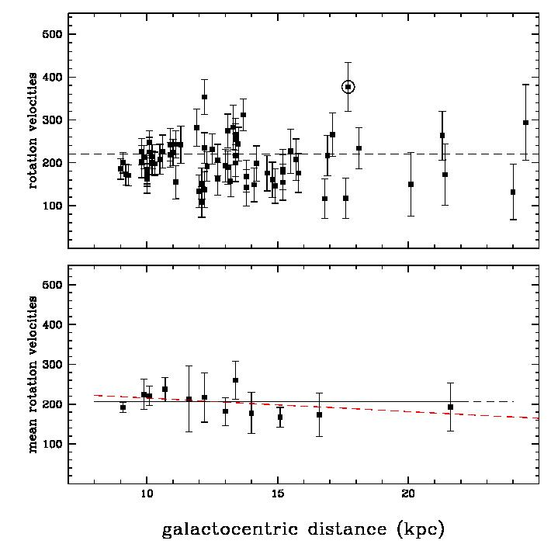
C STARS as kinematical tracers - I
Tracing the MW rotation curve beyond the solar circle up to ~30kpc!
Battinelli, Demers, Rossi, Gigoyan 2012

Slide 13
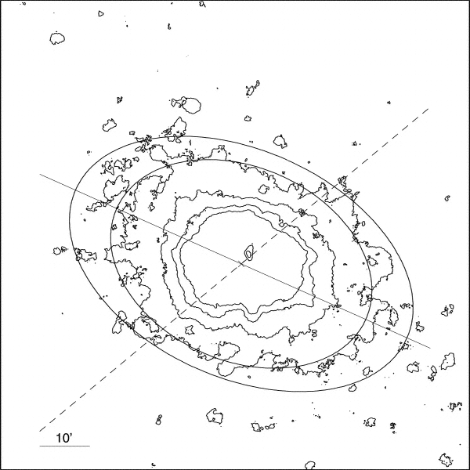
AGB STARS as kinematical tracers - II
One more surprise!
NGC 6822 shows an evident polar-ring structure.
Carbon stars show no preference for the H I disk and they form part of a stellar population rotating at nearly right angles to the H I disk
Demers, Battinelli, Kunkel 2006

Slide 14
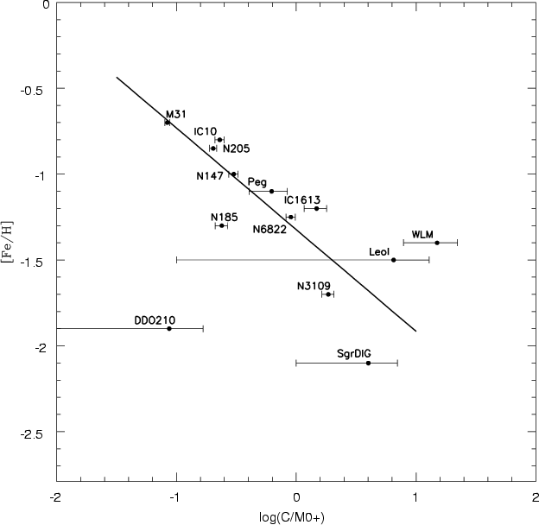
C/M ratio as metallicity proxy
Explained by Iben & Renzini (1983)
Battinelli & Demers, 2005

Slide 15
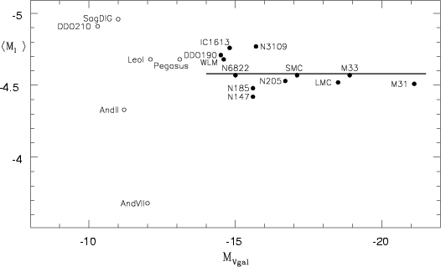
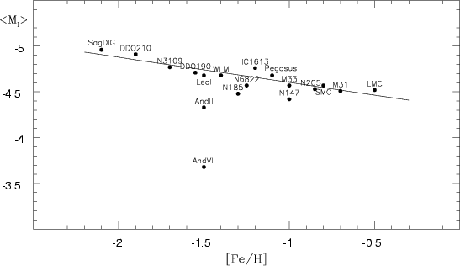
Mean absolute I-mag of C stars
Theoretically expected to be nearly independent of metallicity.
First tentatively used by Richer et al (1983) to determine the distance to NGC 55
Battinelli & Demers, 2005

Slide 16
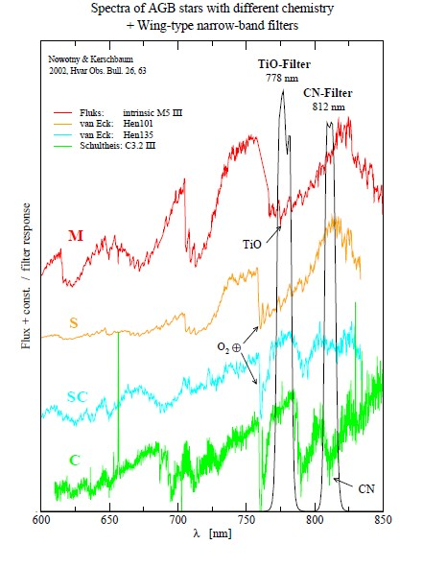
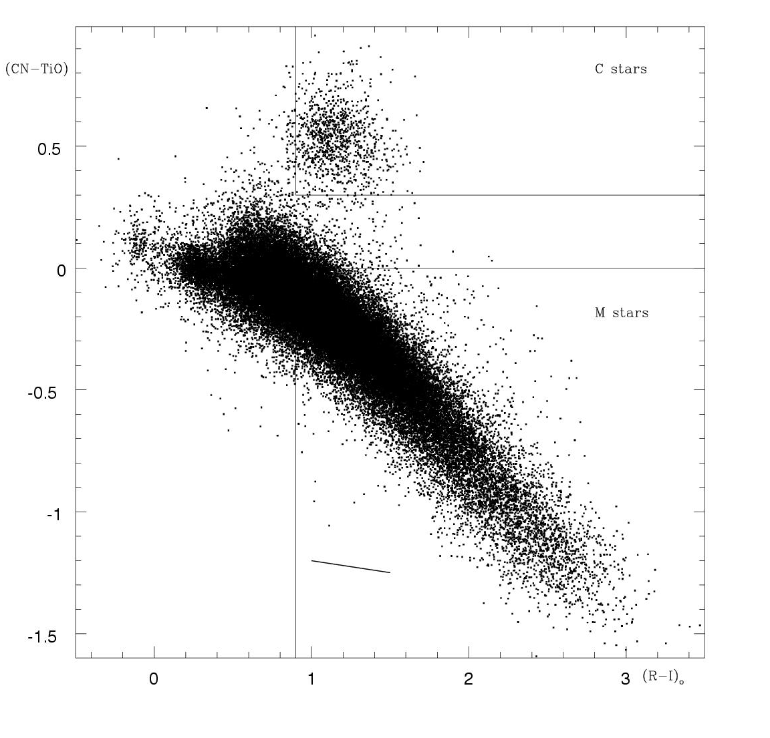
Identifying AGB M and C stars
The narrow band approach
(Palmer&Wing,1982)
(R-I)o>0.9
(CN-TiO)>0.3 → C stars
(CN-TiO)<0.0 → M stars
Nowotny & Kerschbaum, 2002

Slide 17
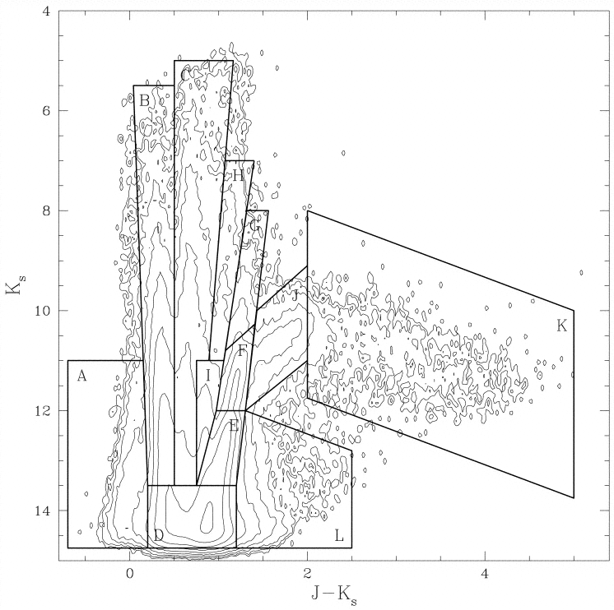
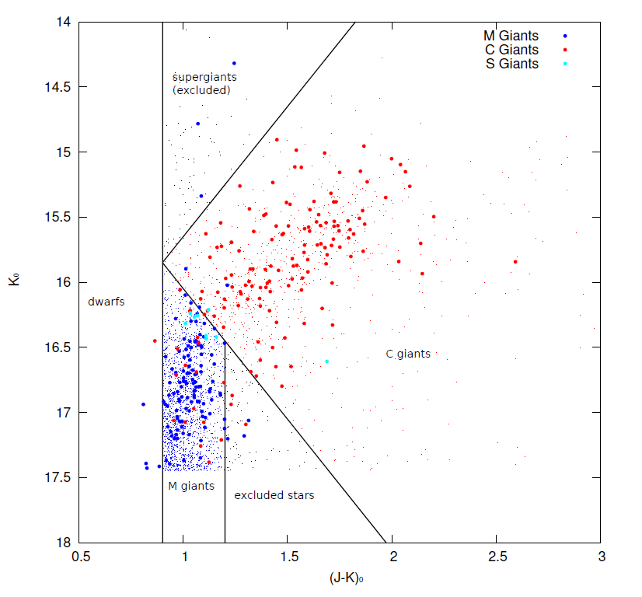
Identifying AGB M and C stars
The NIR approach
Nikolaev & Weinberg, 2000
Kacharov, Rejkuba,Cioni, 2012

Slide 18
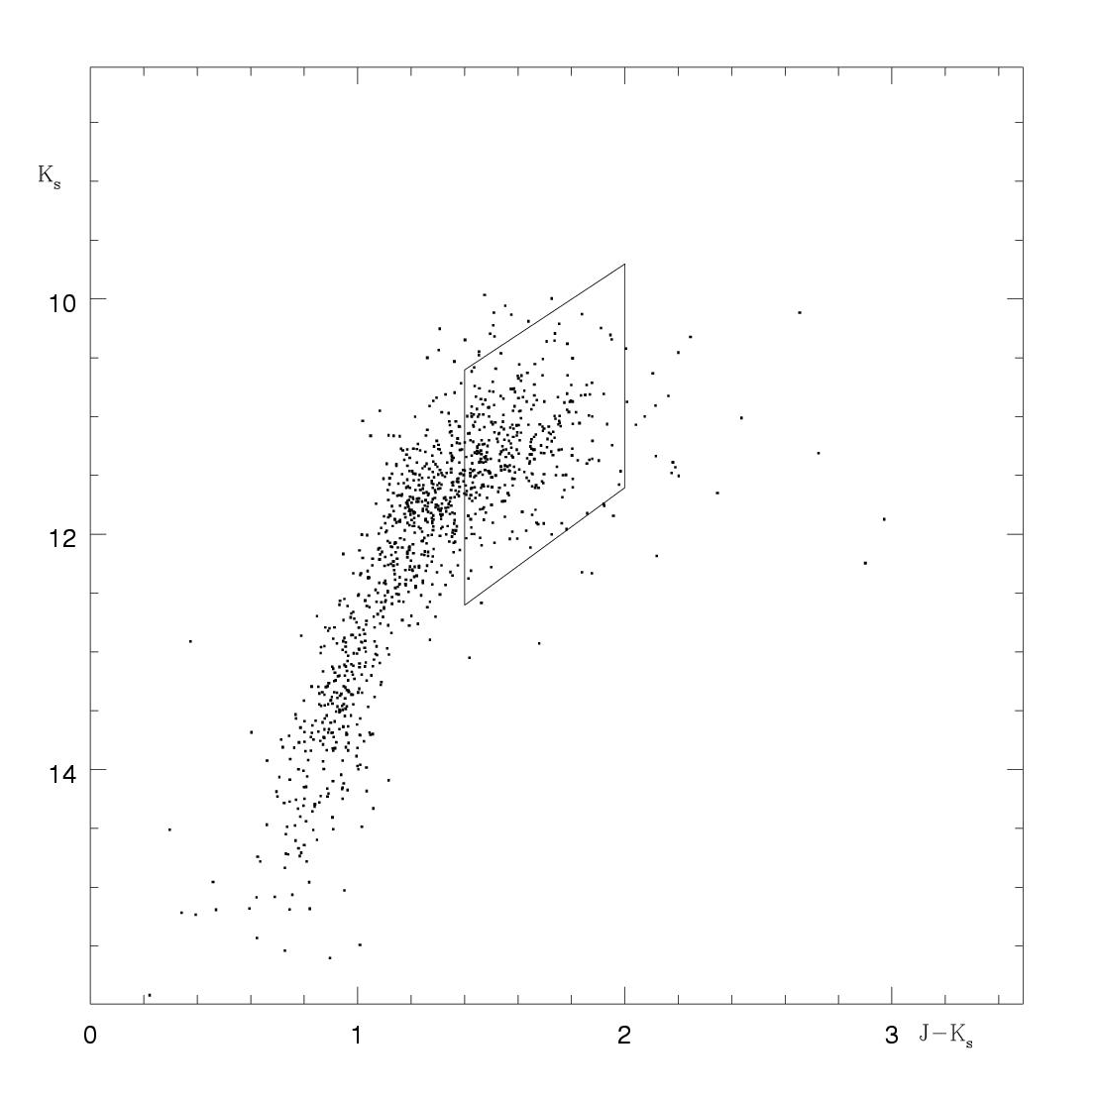
NIR colors of spectroscopically confirmed C stars in the SMC
NIR: 2MASS
Spectroscopy:
Morgan & Hatzidimitriou (1995)
(Demers et al., 2002)

Slide 19
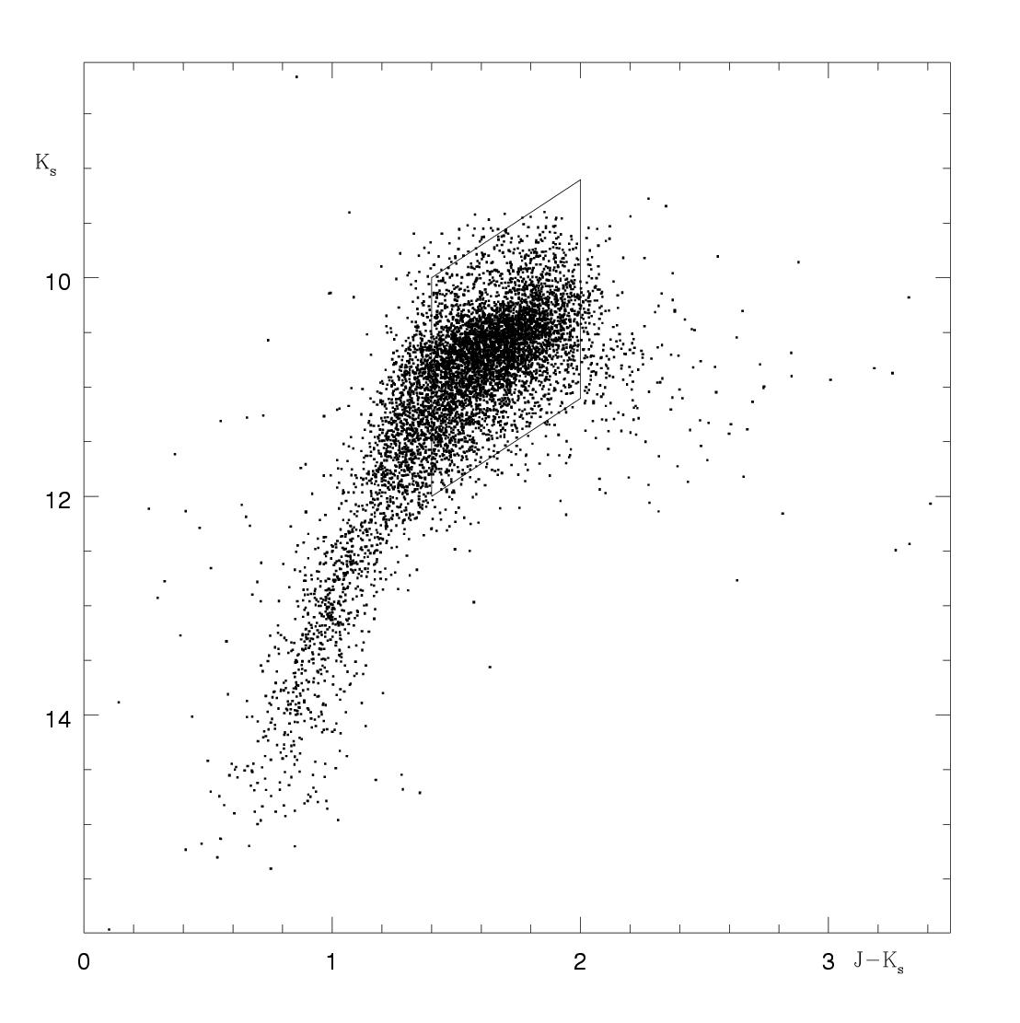
NIR colors of spectroscopically confirmed C stars in the LMC
NIR: 2MASS
Spectroscopy:
Kontizas et al. 2001
(Demers et al., 2002)

Slide 20
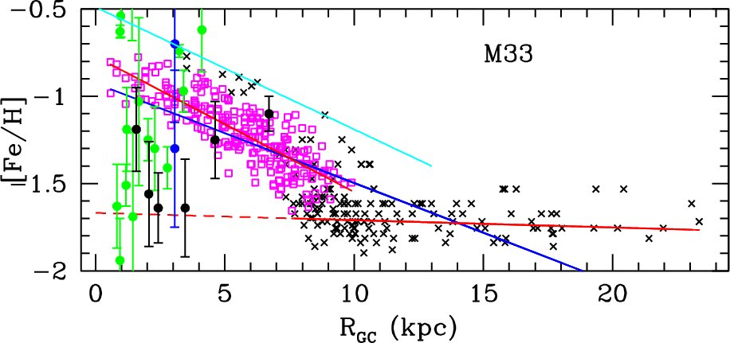
Identifying AGB M and C stars
ATTENTION: RICNTiO and NIR methods are NOT equivalent
C and M counts from NIR (Cioni 2009)
C and M counts from narrow-bands
(Battinelli & Demers, 2011)

Slide 21
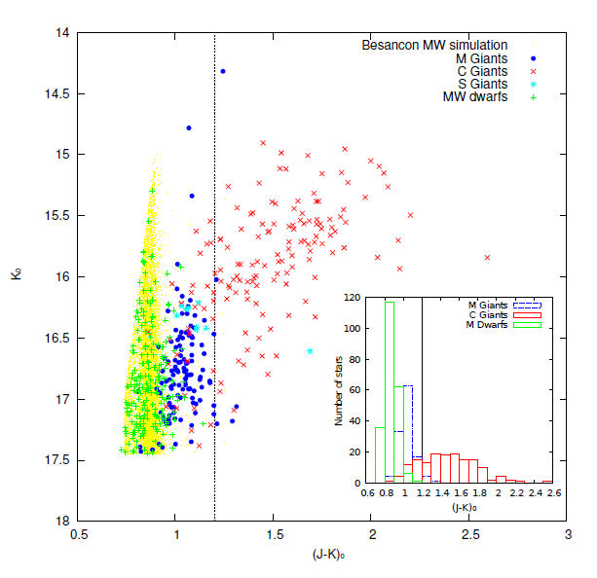
Identifying AGB M and C stars
Kacharov, Rejkuba, Cioni (2012): ~800 VIMOS spectra of bright red stars in NGC 6822 are used to constraint the NIR photometric C-M classification

Slide 22
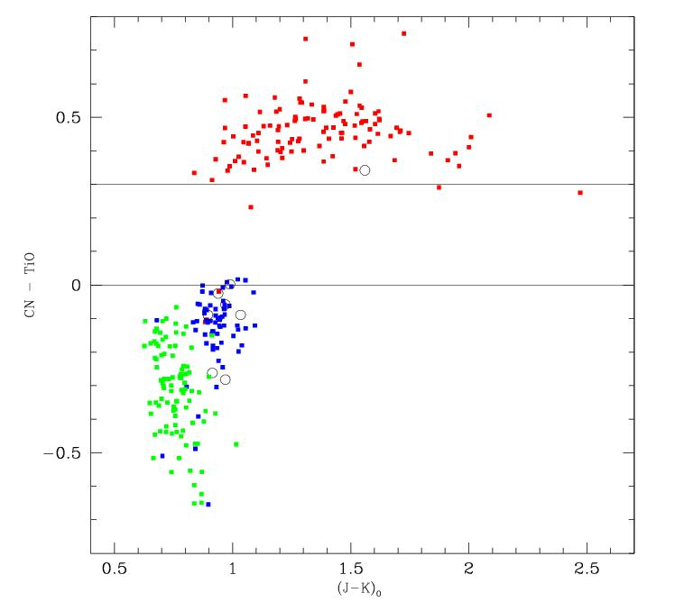
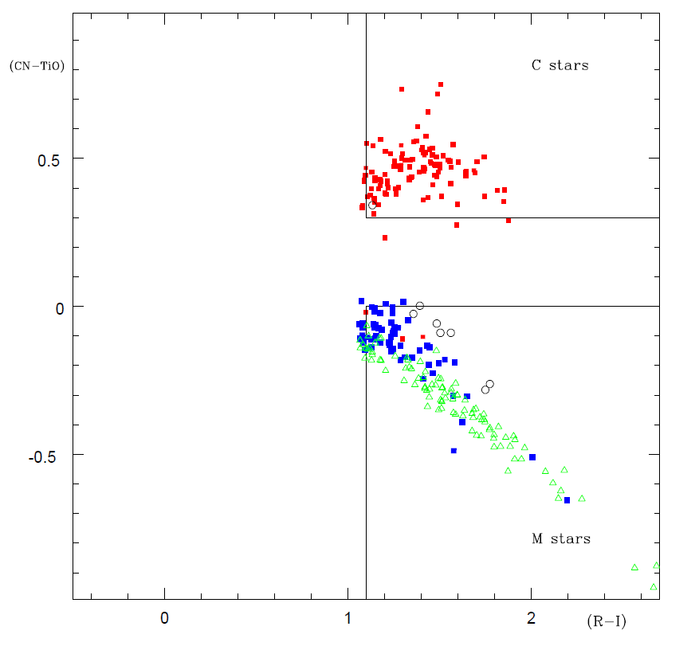
Identifying AGB M and C stars
Kacharov, Rejkuba, Cioni (2012): ~800 VIMOS spectra of bright red stars in NGC 6822 are used to constraint the NIR photometric C-M classification

Slide 23
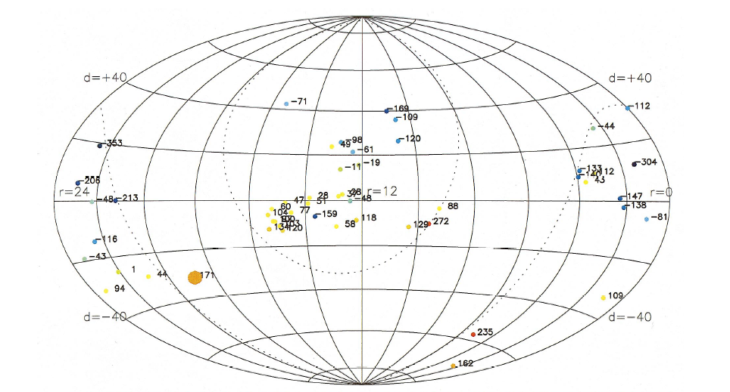
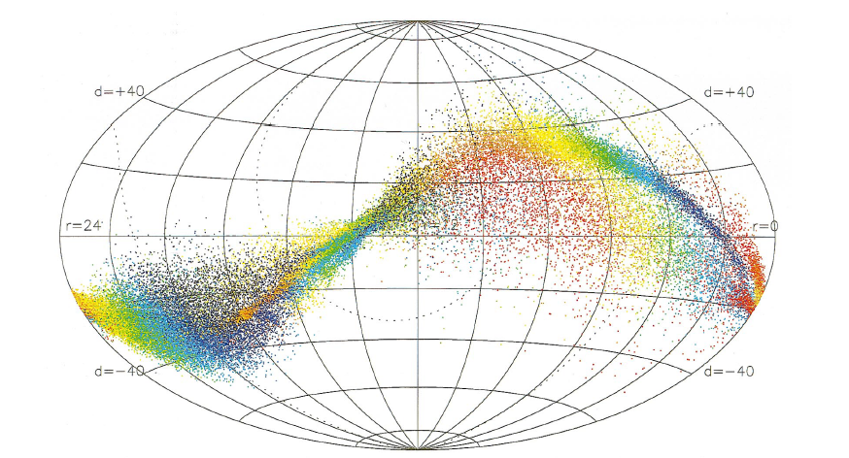
C stars in the galactic halo
Sagittarius dwarf galaxy (Ibata, Gilmore, Irwin 1994) at 16 kpc from the galactic centre
Ibata et al. 2001 noted that the spatial distribution of halo C stars is not at all random.
C stars trace the tidal stream of the disrupting Sgr dwarf galaxy
Ibata et al., 2001

Slide 24
REM and the variability of Halo C stars
Rapid Eye Mount
60cm fast reacting
La Silla / Brera
f.o.v. 10’ x 10’
V,R,I + J,H,K
Demers & Battinelli, 2012

Slide 25
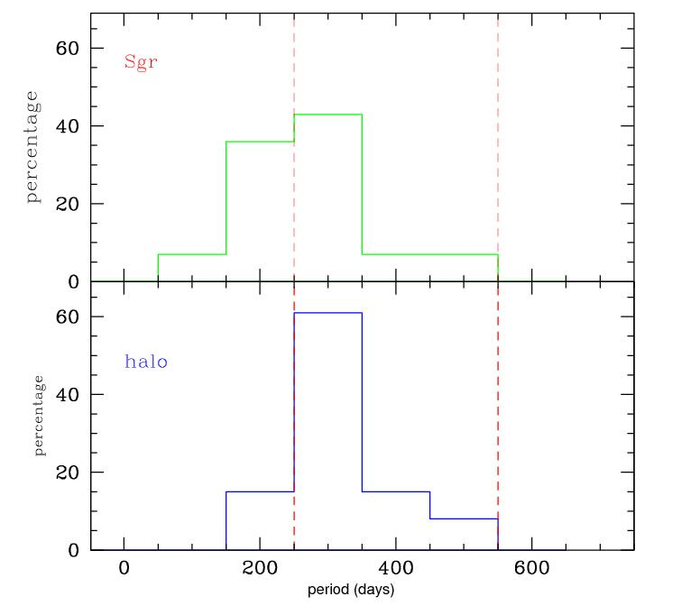
REM and the variability of Halo C stars
Rapid Eye Mount
60cm fast reacting
La Silla / Brera
f.o.v. 10’ x 10’
V,R,I + J,H,K
Demers & Battinelli, 2012
Periods (d) | Ages(Gyr)
< 255 | > 5
255 to 450 | 1 to 3
> 450 | < 1
see e.g.Habing & Whitelock, 2006

Slide 26
figure from Battinelli & Demers, 2012

Slide 27
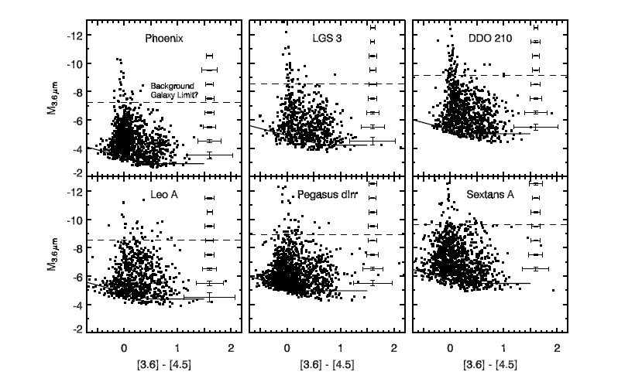
AGB Spitzer’s observations
“… Below this limit, we cannot distinguish between mass-losing AGB stars, background galaxies and other red IR sources (e.g. YSOs) with IRAC data alone.” (Boyer et al., 2009)

